Slide 1
Privilege, ethical, and communication considerations for structural engineers in performing forensic investigations and root cause analysis
Philadelphia, PA – February 19, 2020

Slide 2
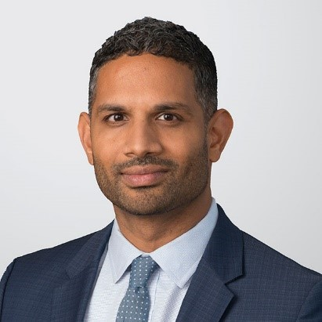
Presenter
Nipun J. Patel
Litigation Partner
Holland & Knight LLP
2929 Arch St., Philadelphia PA
Nipun.patel@hklaw.com

Slide 3
Why should you care?
1. Most of your clients are safety conscious businesses and will engage in post-incident investigation.
2. Clients’ policies require (written?) investigation/analysis
3. Safety records/regulatory/legal reasons for investigations
4. NSPE – ethical guidelines implicated

Slide 4
What’s the ask/task?
Post-incident investigation (different from RCA)
Internal team
External team
Does it matter? (Legally, it may, as we will discuss)

Slide 5
Accident or Incident Investigation Distinguished
Accident investigations are focused on “who, what, when, where, and how.”
Reactive v. Proactive.
Accident investigators react to an accident by photographing the scene, interviewing eye witnesses, and collecting physical evidence
Root cause analyses are focused on the WHY

Slide 6
GOAL REMAINS THE SAME FOR RCA
Identify (objectively/truthfully) WHY the incident happened and provide recommendations to improve safety to eliminate or minimize risks and prevent recurrence.
NPSE Rule of Practice III(a):
Engineers shall be objective and truthful in professional reports, statements, or testimony. . .[and] include all relevant and pertinent information in such reports, statements, or testimony, which should bear the date indicating when it was current.

Slide 7
Best Practice Notes
Identify (disinterested) qualified individuals to conduct investigation
Procedures/protocols – external consultants should evaluate company’s processes for conducting investigations
Timing matters – ASAP
  Prevent evidence from being lost/discarded/destroyed
  Avoid memory of witnesses from fading
Thoroughness matters
  Witness interviews should be in writing (signed/dated acknowledgments help)
  Photographs/measurements together with dates and record of individual taking same

Slide 8
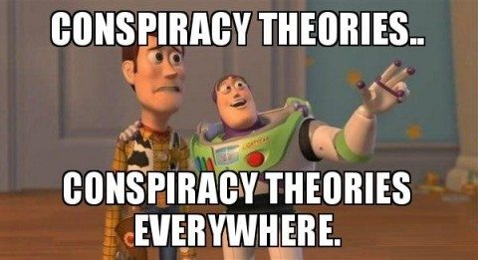
A Note On Preservation

Slide 9
Don’t hide the evidence
Failing to preserve materials can lead to sanctions by the Court
Juries will hold it against your clients or you as a witness
When must preservation begin – “reasonable anticipation of litigation”
BEST PRACTICE NOTE: This does not mean it is MANDATORY to commit everything to writing

Slide 10
Dangers of “Thinking Out Loud In Writing”
The United States is a litigious country
Any accident that results in significant personal injury, property damage, or business interruption may lead to a claim
Speculation about cause, in writing, by individuals with knowledge of the underlying events, poses the greatest threat to unintended consequences

Slide 11
PROFESSIONAL AND LEGAL STANDARDS DISFAVOR SPECULATION
NPSE Professional Rule III
Federal Rule of Evidence 702:
Engineers may express publicly technical opinions that are founded upon knowledge of the facts and competence in the subject matter
(a) expert’s scientific, technical, or other specialized knowledge will help the trier of fact to understand the evidence or to determine a fact in issue
(b) the testimony is based on sufficient facts or data;
(c) the testimony is the product of reliable principles and methods; and
(d) the expert has reliably applied the principles and methods to the facts of the case.

Slide 12
Lessons Learned
Speculation doesn’t help anyone
If you believe there are multiple potential root causes or the root cause is indeterminable – just say so! “Anything is possible”
Involving an internal or external lawyer could have helped preserve privilege with regard to the root cause analysis
Merely copying a lawyer will not shield communications from litigation discovery; but communicating with the purpose of seeking legal advice or seeking legal review or comment could help preserve privilege of communications in later litigation.

Slide 13
More Lessons Learned
Facts (raw data, measurements, witness statements) are never privileged.
A word on Federal Rule of Evidence 407 – “When measures are taken that would have made an earlier injury or harm less likely to occur, evidence of the subsequent measures is not admissible to prove:
  negligence; culpable conduct; a defect in a product or its design; or a need for a warning or instruction.”
Law encourages companies to examine steps that could prevent injury or event

Slide 14
You can incorporate Rule 407 into RCA
Adopting a company policy that tracks the language of Federal Rule of Evidence 407 regarding subsequent remedial measures might help.
Policy could say: “For any root cause analysis prepared in direct response to an event where litigation is anticipated, the analysis is not intended to identify specific acts or causes and is intended only to identify remedial measures to all acts, causes or processes that may make the event less likely to occur in the future.”
Try to make sure that your good deeds in fact go unpunished.

Slide 15
Other ideas
Limit the distribution list to those who need to know (verbal discussions with high level executives if possible)
Limiting the dissemination of documents and information to team members, attorneys, high-level executives, or a combination of these.
You can always share results and recommendations from the analysis with a broader group at a later point if chance of immediate recurrence is low.

Slide 16
What about work product and privilege?
Documents created in anticipation of litigation are typically subject to a work product privilege in state and federal court.
Not necessarily limited to attorneys -- a party or its representative can create work product if prepared in anticipation of litigation.
You can state this on the RCA or other documents “prepared in anticipation of litigation”
Engagement letters should specify that engagement is made in anticipation of litigation and it is anticipated that engineering firm will create work product

Slide 17
Anticipation of litigation –
Involving Lawyers Helps
Case study: Transocean Deepwater, Inc. v. Ingersoll- Rand Co., No. 08-04448, 2010 WL 5374744 (E.D. La. Dec. 21, 2010)
Personal injury claim where Transocean promptly investigated an incident in which a crewman’s toes were amputated.
Transocean retained outside counsel to investigate the scene the day after the accident, and the counsel prepared a draft report based on his observations
Court held privilege applied – Why? Outside counsel retained unlike ordinary RCA and mental impressions of counsel should not be disclosed.

Slide 18
But not always
Chevron Midstream Pipelines LLC v. Settoon Towing LLC, Civ. Action Nos. 13-2809, 13-3197, 2015 WL 65357 (E.D. La. Jan. 5, 2015)
Chevron’s in-house lawyers conducted an internal investigation of pipeline leak and fire.
Report was prepared in the ordinary course of business -- not to assist with anticipated litigation. Court assessed company testimony, handbooks, and statements as indicating that such reports were prepared routinely after any incident involving the company.

Slide 19
Privileges can always be waived
Forwarding root cause analysis that is otherwise privilege to 3rd parties like PR firms may result in waiver of privilege
Issue being decided right now by PA courts – key question is whether under the facts of the case the forwarding was done with an expectation of confidentiality.
Don’t forward within organization or firm without express permission.
NPSE Code of Ethics Rule IV – “Engineers shall not disclose, without consent, confidential information concerning the business affairs or technical processes of any present or former client or employer, or public body on which they serve”

Slide 20
Other thoughts on report writing
K-I-S-S and remember that there is a performance aspect.
Attach the photographs and data being relied on. Use charts, graphs, visual aids.
Cite the pertinent codes, principles, equations, data, etc. – makes you more credible.
Be competent in the subject matter. Easy to sort out pretenders.
NPSE Code of Ethics -- “Engineers, in the fulfillment of their professional duties, shall: . . .Perform services only in areas of their competence.”

Slide 21
Other thoughts on report writing
Your underlying emails may be uncovered – focus on precise written communication needs to be beyond the report itself
Sub-contractors or consultants should understand the rules of the game as well
Don’t be afraid to ask for more compete information
Emphatically note the absence of cooperation or information
If your making an assumption, clearly state the scope of those assumptions and be prepared to defend why they were chosen

